Slide 1
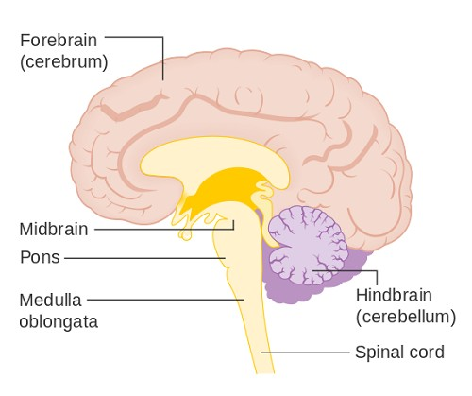
Medulla and Pons
NSC 4130 LAB

Slide 2
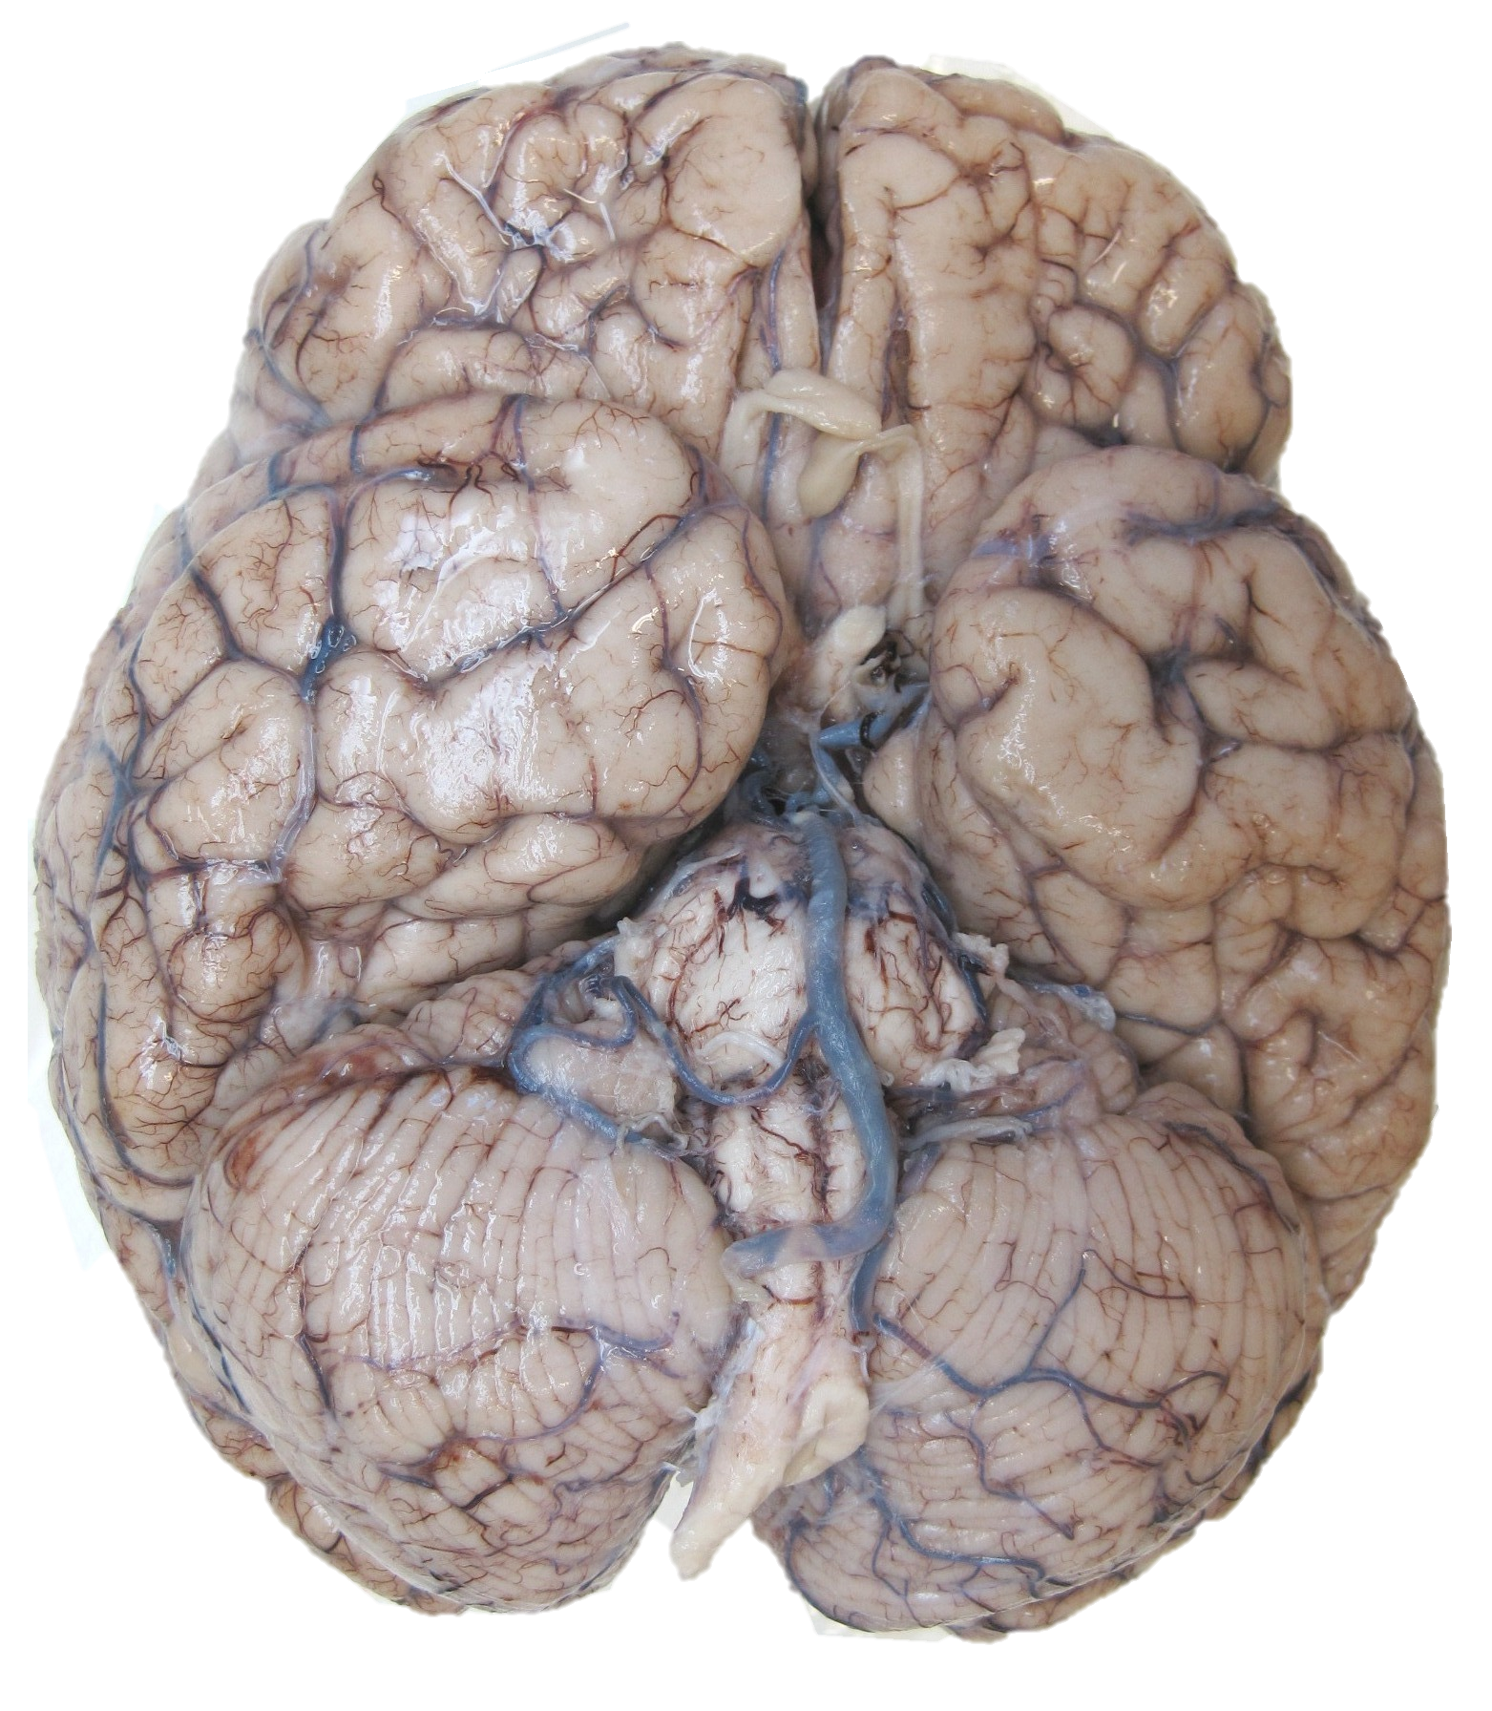
Pons
Medulla

Slide 3
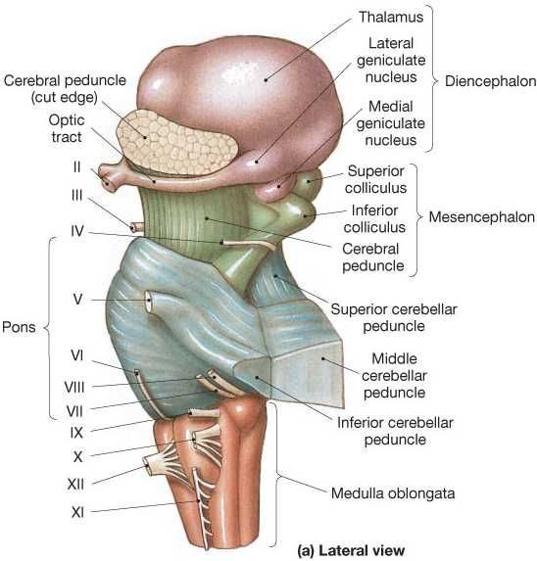

Slide 4
Medulla Structures
Hypoglossal nucleus → cranial motor nerve nucleus
Solitary tract → stretch and chemoreceptors of the cardiovascular, respiratory, and intestinal tracts Trigeminal nerve → cranial nerve V
Face sensations
Biting and chewing motor functions
Olivary Nucleus
Coordinates signals from the spinal cord to the cerebellum to regulate motor coordination and learning
Pyramidal tract
Upper motor neurons that originate in the cerebral cortex and terminate in the spinal cord or brainstem
Nucleus Ambiguous → cranial nerves IX and X (speech and swallowing)

Slide 5
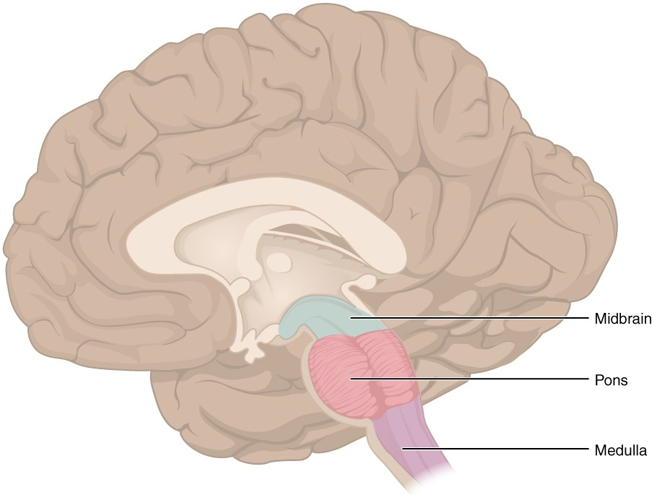
Medulla Function
Autonomic Control
Cardiac – sympathetic and parasympathetic functioning
Respiratory – chemoreceptors: detect variation of the oxygen concentration in blood
Reflexes – vomiting, coughing, sneezing, and swallowing
Vasomotor – baroreceptors: detect changes in blood pressure
Decussation of sensory fibers
Obex
Notes:
While your sympathetic nervous system carries signals that put your body's systems on alert, your parasympathetic carries signals that relax those systems.
Baroreceptors detect changes in blood pressure and are found in the aortic and carotid bodies. Chemoreceptors detect the concentration of oxygen in the blood

Slide 6
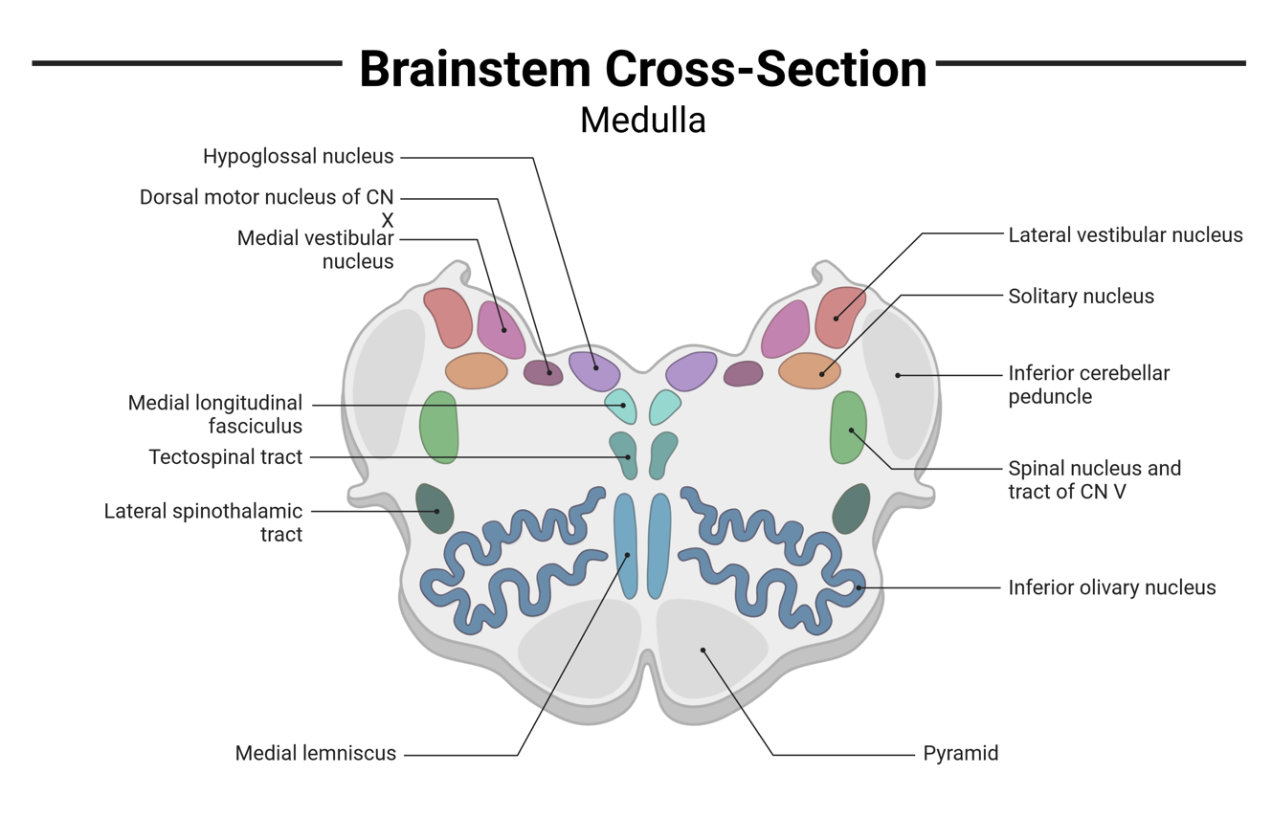

Slide 8
Pons Function
Autonomic nerve pathways
Integration of information
Exerts some control over:
  Regulation of respiration
  involuntary actions
  Sensory roles: hearing, equilibrium, taste, and in facial sensations such as touch and pain
  Motor roles: eye movement, facial expressions, chewing, swallowing, and the secretion of saliva and tears

Slide 9
Pons Structures
2 major divisions:
  Basilar part of the pons (ventral pons)
  Pontine tegmentum (dorsal pons)
Lemniscus = secondary sensory fiber
Fasciculus = nerve and motor bundles

Slide 10
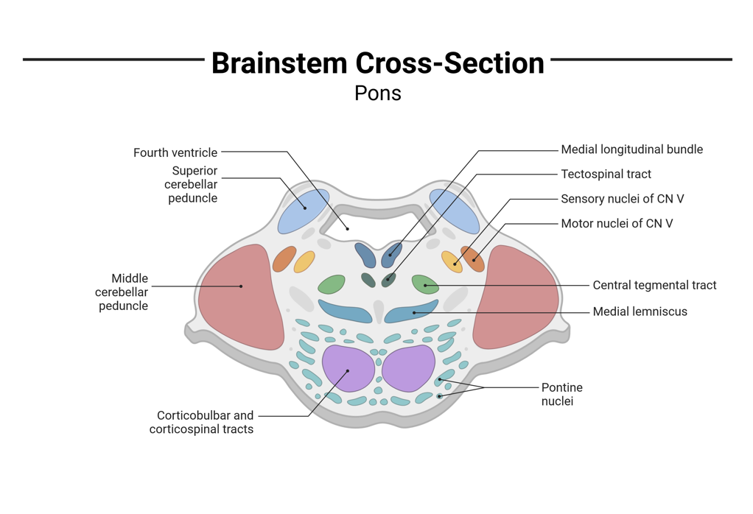

Slide 11
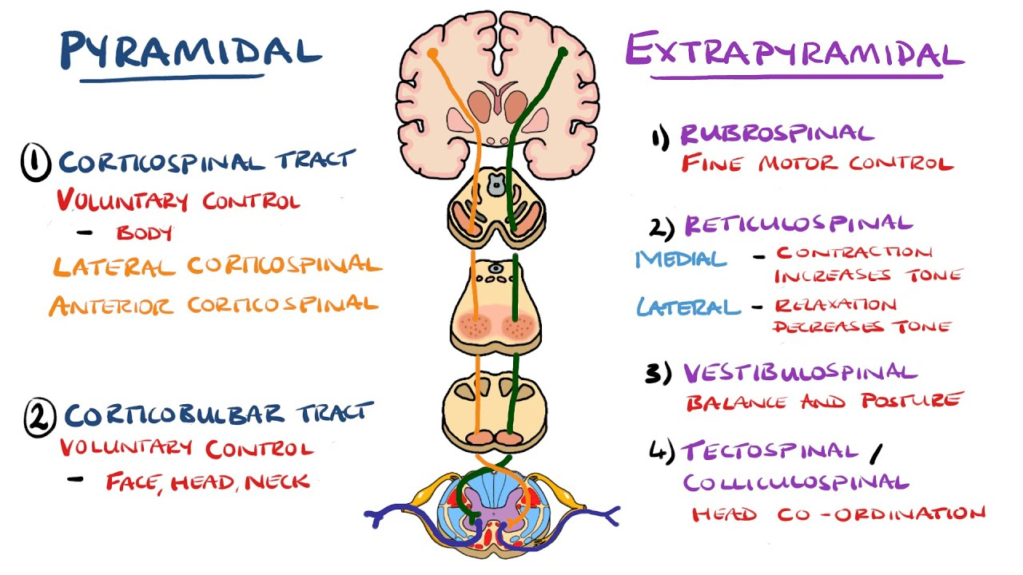
Midbrain
Pons
Medulla

Slide 12
Midbrain
Pons
Medulla

Slide 13
Pyramidal Tracts : Corticospinal and Corticobulbar

Slide 14
Motor Tracts
Tract | Path | Function
corticospinal tract | Motor Cortex ➔ Spinal Cord (LMN in ventral horn) | voluntary motor control of the limbs and voluntary posture adjustments
corticobulbar tract | Motor Cortex ➔ Medulla and Pons | swallowing, tongue movement, facial and jaw muscles
colliculospinal tract (tectospinal tract) | Superior Colliculus ➔ LMN | involuntary head movements
rubrospinal tract | Red Nucleus ➔ LMN | involuntary arm movements (for balance) and body support
vestibulospinal tract | Vestibular Nucleus ➔ LMN | posture and balance
reticulospinal tract | Reticular Formation ➔ LMN | various involuntary motor movements and assists with balance
LMN = lower motor neurons

Slide 15
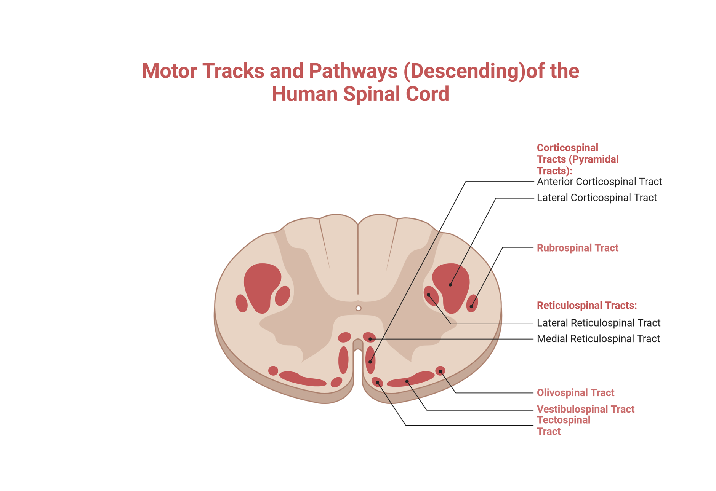

Slide 16
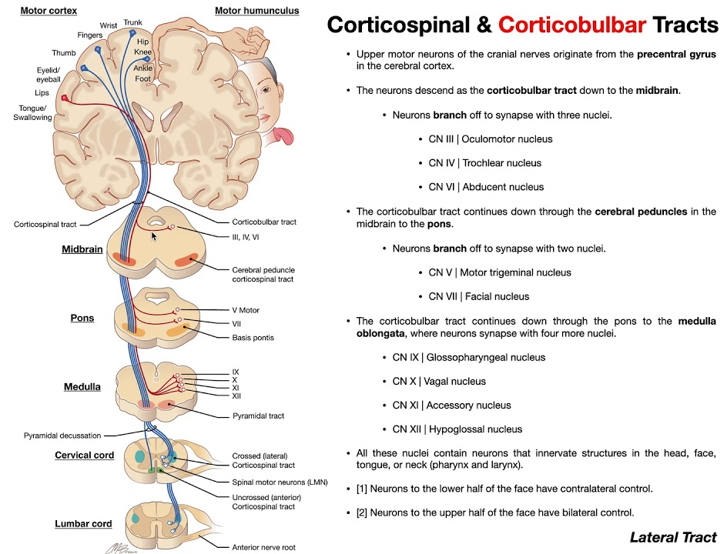
Notes:
https://www.ncbi.nlm.nih.gov/books/NBK555891/#:~:text=Corticobulbar%20tract%20carries%20upper%20motor,the%20muscles%20of%20facial%20expression.

Slide 17
Motor Tracts
Tract | Path | Function
corticospinal tract | Motor Cortex ➔ Spinal Cord (LMN in ventral horn) | voluntary motor control of the limbs and voluntary posture adjustments
corticobulbar tract | Motor Cortex ➔ Medulla and Pons | swallowing, tongue movement, facial and jaw muscles
colliculospinal tract (tectospinal tract) | Superior Colliculus ➔ LMN | involuntary head movements
rubrospinal tract | Red Nucleus ➔ LMN | involuntary arm movements (for balance) and body support
vestibulospinal tract | Vestibular Nucleus ➔ LMN | posture and balance
reticulospinal tract | Reticular Formation ➔ LMN | various involuntary motor movements and assists with balance
LMN = lower motor neurons

Slide 18
Extra Pyramidal Tracts :reticulospinal, vestibulospinal, rubrospinal and tectospinal/ Colliculospinal tracts

Slide 19
Motor Tracts
Tract | Path | Function
corticospinal tract | Motor Cortex ➔ Spinal Cord (LMN in ventral horn) | voluntary motor control of the limbs and voluntary posture adjustments
corticobulbar tract | Motor Cortex ➔ Medulla and Pons | swallowing, tongue movement, facial and jaw muscles
colliculospinal tract (tectospinal tract) | Superior Colliculus ➔ LMN | involuntary head movements
rubrospinal tract | Red Nucleus ➔ LMN | involuntary arm movements (for balance) and body support
vestibulospinal tract | Vestibular Nucleus ➔ LMN | posture and balance
reticulospinal tract | Reticular Formation ➔ LMN | various involuntary motor movements and assists with balance
LMN = lower motor neurons

Slide 21
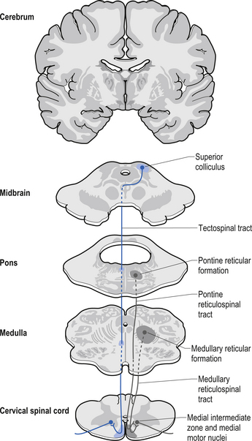
Extrapyramidal Tracts: Colliculospinal/tectospinal
Notes:
https://www.ncbi.nlm.nih.gov/books/NBK554542/

Slide 22
Motor Tracts
Tract | Path | Function
corticospinal tract | Motor Cortex ➔ Spinal Cord (LMN in ventral horn) | voluntary motor control of the limbs and voluntary posture adjustments
corticobulbar tract | Motor Cortex ➔ Medulla and Pons | swallowing, tongue movement, facial and jaw muscles
colliculospinal tract (tectospinal tract) | Superior Colliculus ➔ LMN | involuntary head movements
rubrospinal tract | Red Nucleus ➔ LMN | involuntary arm movements (for balance) and body support
vestibulospinal tract | Vestibular Nucleus ➔ LMN | posture and balance
reticulospinal tract | Reticular Formation ➔ LMN | various involuntary motor movements and assists with balance
LMN = lower motor neurons

Slide 23
Motor Tracts: Rubrospinal
Tract | Path | Function
corticospinal tract | Motor Cortex ➔ Spinal Cord (LMN in ventral horn) | voluntary motor control of the limbs and voluntary posture adjustments
corticobulbar tract | Motor Cortex ➔ Medulla and Pons | swallowing, tongue movement, facial and jaw muscles
colliculospinal tract (tectospinal tract) | Superior Colliculus ➔ LMN | involuntary head movements
rubrospinal tract | Red Nucleus ➔ LMN | involuntary arm movements (for balance) and body support
vestibulospinal tract | Vestibular Nucleus ➔ LMN | posture and balance
reticulospinal tract | Reticular Formation ➔ LMN | various involuntary motor movements and assists with balance
LMN = lower motor neurons

Slide 25
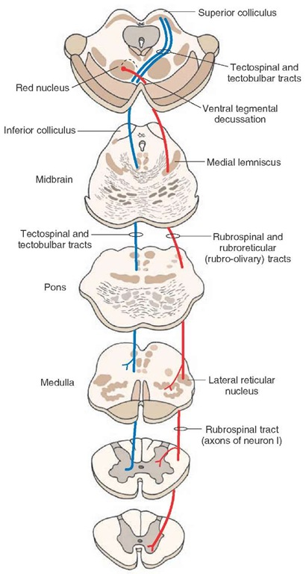
Extrapyramidal Tracts: Rubrospinal
Notes:
https://www.ncbi.nlm.nih.gov/books/NBK554542/

Slide 26
Motor Tracts
Tract | Path | Function
corticospinal tract | Motor Cortex ➔ Spinal Cord (LMN in ventral horn) | voluntary motor control of the limbs and voluntary posture adjustments
corticobulbar tract | Motor Cortex ➔ Medulla and Pons | swallowing, tongue movement, facial and jaw muscles
colliculospinal tract (tectospinal tract) | Superior Colliculus ➔ LMN | involuntary head movements
rubrospinal tract | Red Nucleus ➔ LMN | involuntary arm movements (for balance) and body support
vestibulospinal tract | Vestibular Nucleus ➔ LMN | posture and balance
reticulospinal tract | Reticular Formation ➔ LMN | various involuntary motor movements and assists with balance
LMN = lower motor neurons

Slide 27
Motor Tracts
Tract | Path | Function
corticospinal tract | Motor Cortex ➔ Spinal Cord (LMN in ventral horn) | voluntary motor control of the limbs and voluntary posture adjustments
corticobulbar tract | Motor Cortex ➔ Medulla and Pons | swallowing, tongue movement, facial and jaw muscles
colliculospinal tract (tectospinal tract) | Superior Colliculus ➔ LMN | involuntary head movements
rubrospinal tract | Red Nucleus ➔ LMN | involuntary arm movements (for balance) and body support
vestibulospinal tract | Vestibular Nucleus ➔ LMN | posture and balance
reticulospinal tract | Reticular Formation ➔ LMN | various involuntary motor movements and assists with balance
LMN = lower motor neurons

Slide 28
Motor Tracts: Vestibulospinal
Tract | Path | Function
corticospinal tract | Motor Cortex ➔ Spinal Cord (LMN in ventral horn) | voluntary motor control of the limbs and voluntary posture adjustments
corticobulbar tract | Motor Cortex ➔ Medulla and Pons | swallowing, tongue movement, facial and jaw muscles
colliculospinal tract (tectospinal tract) | Superior Colliculus ➔ LMN | involuntary head movements
rubrospinal tract | Red Nucleus ➔ LMN | involuntary arm movements (for balance) and body support
vestibulospinal tract | Vestibular Nucleus ➔ LMN | posture and balance
reticulospinal tract | Reticular Formation ➔ LMN | various involuntary motor movements and assists with balance
LMN = lower motor neurons

Slide 30
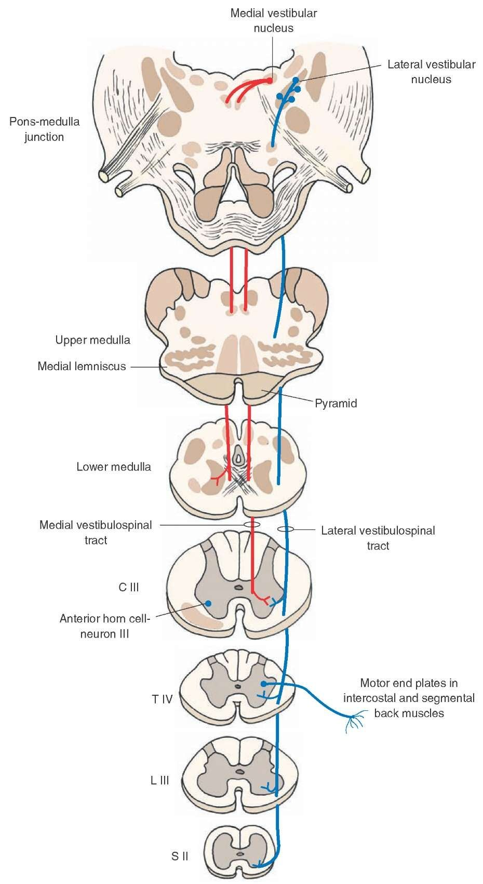
Extrapyramidal Tracts: Vestibulospinal
Notes:
https://www.ncbi.nlm.nih.gov/books/NBK554542/

Slide 31
Motor Tracts: Vestibulospinal
Tract | Path | Function
corticospinal tract | Motor Cortex ➔ Spinal Cord (LMN in ventral horn) | voluntary motor control of the limbs and voluntary posture adjustments
corticobulbar tract | Motor Cortex ➔ Medulla and Pons | swallowing, tongue movement, facial and jaw muscles
colliculospinal tract (tectospinal tract) | Superior Colliculus ➔ LMN | involuntary head movements
rubrospinal tract | Red Nucleus ➔ LMN | involuntary arm movements (for balance) and body support
vestibulospinal tract | Vestibular Nucleus ➔ LMN | posture and balance
reticulospinal tract | Reticular Formation ➔ LMN | various involuntary motor movements and assists with balance
LMN = lower motor neurons

Slide 32
Motor Tracts: Vestibulospinal
Tract | Path | Function
corticospinal tract | Motor Cortex ➔ Spinal Cord (LMN in ventral horn) | voluntary motor control of the limbs and voluntary posture adjustments
corticobulbar tract | Motor Cortex ➔ Medulla and Pons | swallowing, tongue movement, facial and jaw muscles
colliculospinal tract (tectospinal tract) | Superior Colliculus ➔ LMN | involuntary head movements
rubrospinal tract | Red Nucleus ➔ LMN | involuntary arm movements (for balance) and body support
vestibulospinal tract | Vestibular Nucleus ➔ LMN | posture and balance
reticulospinal tract | Reticular Formation ➔ LMN | various involuntary motor movements and assists with balance
LMN = lower motor neurons

Slide 33
Motor Tracts: Reticulospinal
Tract | Path | Function
corticospinal tract | Motor Cortex ➔ Spinal Cord (LMN in ventral horn) | voluntary motor control of the limbs and voluntary posture adjustments
corticobulbar tract | Motor Cortex ➔ Medulla and Pons | swallowing, tongue movement, facial and jaw muscles
colliculospinal tract (tectospinal tract) | Superior Colliculus ➔ LMN | involuntary head movements
rubrospinal tract | Red Nucleus ➔ LMN | involuntary arm movements (for balance) and body support
vestibulospinal tract | Vestibular Nucleus ➔ LMN | posture and balance
reticulospinal tract | Reticular Formation ➔ LMN | various involuntary motor movements and assists with balance
LMN = lower motor neurons

Slide 35
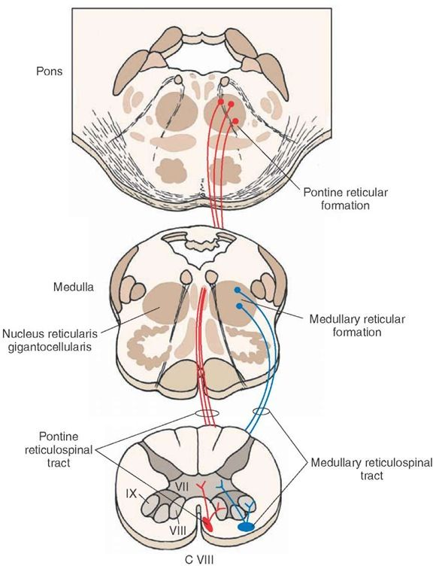
Extrapyramidal Tracts: Reticulospinal
Notes:
https://www.ncbi.nlm.nih.gov/books/NBK554542/

Slide 36
Motor Tracts: Reticulospinal
Tract | Path | Function
corticospinal tract | Motor Cortex ➔ Spinal Cord (LMN in ventral horn) | voluntary motor control of the limbs and voluntary posture adjustments
corticobulbar tract | Motor Cortex ➔ Medulla and Pons | swallowing, tongue movement, facial and jaw muscles
colliculospinal tract (tectospinal tract) | Superior Colliculus ➔ LMN | involuntary head movements
rubrospinal tract | Red Nucleus ➔ LMN | involuntary arm movements (for balance) and body support
vestibulospinal tract | Vestibular Nucleus ➔ LMN | posture and balance
reticulospinal tract | Reticular Formation ➔ LMN | various involuntary motor movements and assists with balance
LMN = lower motor neurons

Slide 37
Motor Tracts: Reticulospinal
Tract | Path | Function
corticospinal tract | Motor Cortex ➔ Spinal Cord (LMN in ventral horn) | voluntary motor control of the limbs and voluntary posture adjustments
corticobulbar tract | Motor Cortex ➔ Medulla and Pons | swallowing, tongue movement, facial and jaw muscles
colliculospinal tract (tectospinal tract) | Superior Colliculus ➔ LMN | involuntary head movements
rubrospinal tract | Red Nucleus ➔ LMN | involuntary arm movements (for balance) and body support
vestibulospinal tract | Vestibular Nucleus ➔ LMN | posture and balance
reticulospinal tract | Reticular Formation ➔ LMN | various involuntary motor movements and assists with balance
LMN = lower motor neurons

Slide 38
Motor Tracts
Tract | Path | Function
corticospinal tract | Motor Cortex ➔ Spinal Cord (LMN in ventral horn) | voluntary motor control of the limbs and voluntary posture adjustments
corticobulbar tract | Motor Cortex ➔ Medulla and Pons | swallowing, tongue movement, facial and jaw muscles
colliculospinal tract (tectospinal tract) | Superior Colliculus ➔ LMN | involuntary head movements
rubrospinal tract | Red Nucleus ➔ LMN | involuntary arm movements (for balance) and body support
vestibulospinal tract | Vestibular Nucleus ➔ LMN | posture and balance
reticulospinal tract | Reticular Formation ➔ LMN | various involuntary motor movements and assists with balance
LMN = lower motor neurons
Notes:
https://www.ncbi.nlm.nih.gov/books/NBK554542/

Slide 39
Bonus Points: +5 points on your lowest quiz (out of 100 points)
Make one of the following:
Make a test with the materials you have learned today (with a test answer key)
Make a study guide
Make a quiz on quizlet
Make note cards with the material
Must include: origin, end and function of all 6 tracks discussed today, function of medulla and pons, and brainstem cross section of pons and medulla

